Slide 1
Hovercraft VDP 2
Group 13
Paul Longe
Bradley
Keqi
Divine
Xiang
Alex

Slide 2
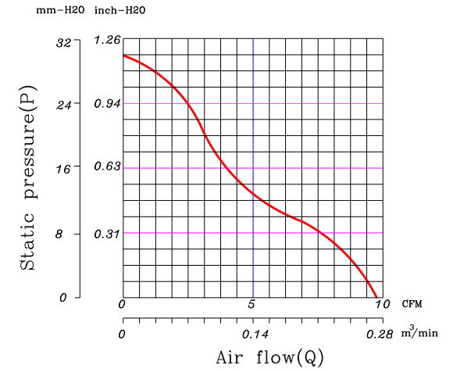
Fans-Materials & Total Cost
Alexandros Iakovos Agrafiotis – Design Engineer
Axial Fan, Centrifugal Fan & Material Selection
Basic material is going to be the Craft foam Blue because it is thick (25mm) strong enough for not breaking with the load and it is very light. Also, easy to change the shape. Cost is £12/ m² .
A centrifugal fan is going to be used for the lift as it needs low power to produce high pressure.
An axial fan is going to be used for the thrust of the hovercraft as it produces high air flow and it needs low power in order to work efficiently.
The total cost of the hovercraft is going to be around £130
Diagram 1- Static Pressure versus Air flow
Calculations Pressure needed to lift a hovercraft for A3 size around 2kg is : P= F/A = 162.81 Pa
Where F= m x g =19.62 & A= size A3 – hole of fan = 0.120505 m² In order to produce the pressure needed we will need low air flow under 2.29 m/s. That means the total pressure is the Static Pressure and the Dynamic Pressure: P_{t} = P_{s} + P_{d} = 173.73 + 3.21= 176.97 Pa Where P_{d} = ½ x ρ x v² = 3.21 Pa
We are not able to calculate the air flow and thrust from the Axial Fan as it is going to be with custom blades and a motor that produces 7800 rpm.
Centrifugal Fan (Lift) Specifications
Rated Voltage | 12V | 7V Min.
Rated Current | 0.46 Amp | 0.55 Amp Max.
Rated Power | 5.52 W | At 12V
Speed | 4500RPM | ±10%
Dimensions | L × W × H (mm) | 75 × 75 × 15.4
Weight | 55 grams | -

